Slide 1
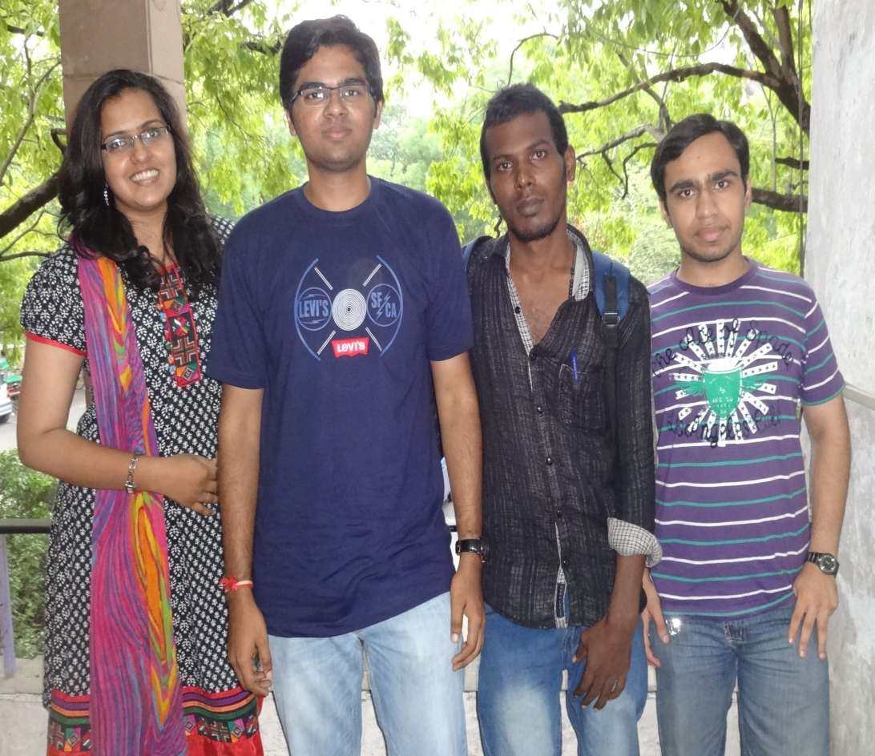
THE MODERNIZERS
Team Members:-
Jameela Zaveri
Rahul Ratnakar
Prabhakaran
Sahil Markan

Slide 2
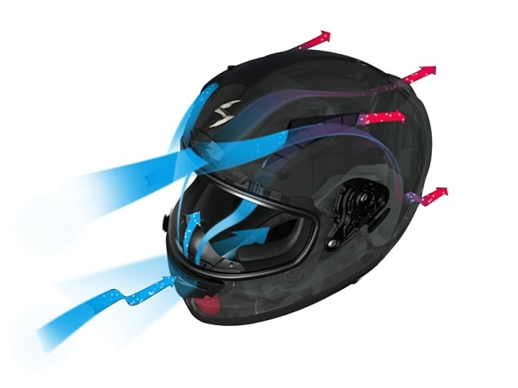
Top 3 Stories
Techno-restaurant.
Usage of wasted heat from AC’s.
Ventilated helmets.

Slide 3
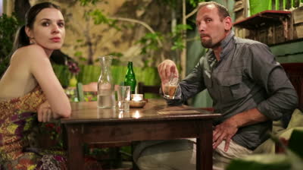
Inspiration
People need a new creative dining joint because they are bored of the conventional way of hotel services.
Trying to opt for something new and interesting, at times we land up ordering items we do not enjoy eating.

Slide 4
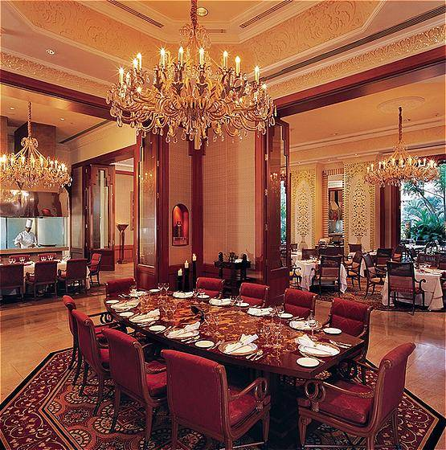
Introducing a new high-tech restaurant management.

Slide 5
Solution..
Food can be ordered directly from the tab provided on every table.
Your order will directly be sent to the chef. Once prepared, your meal will be sent to you through a special arrangement from under your table with the help of conveyor belts and a lifting mechanism.
Similarly, after dinner the payment shall be done online from the same tablet.

Slide 6
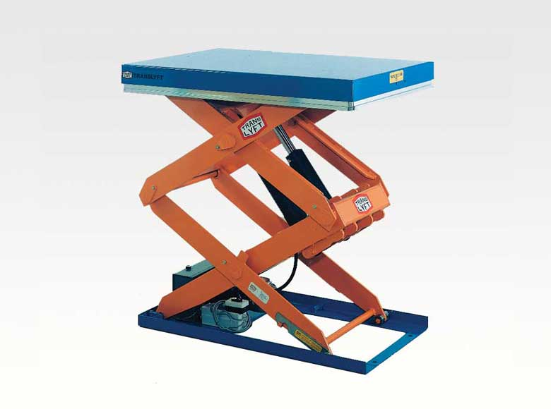
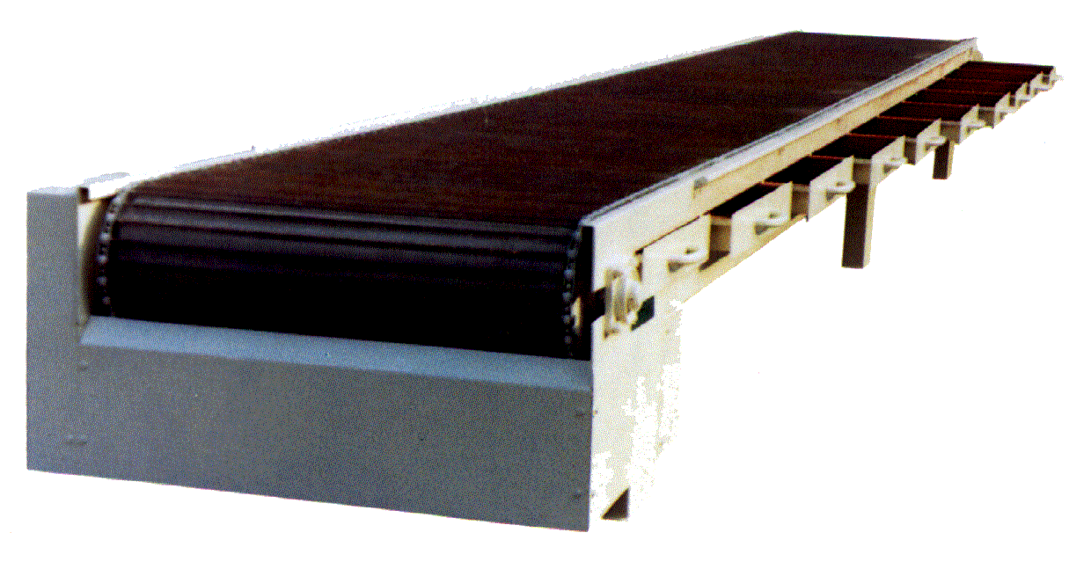
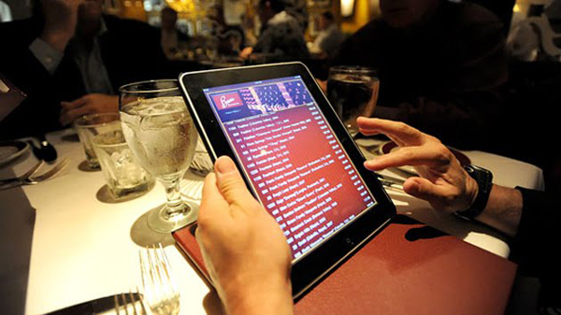


Slide 7
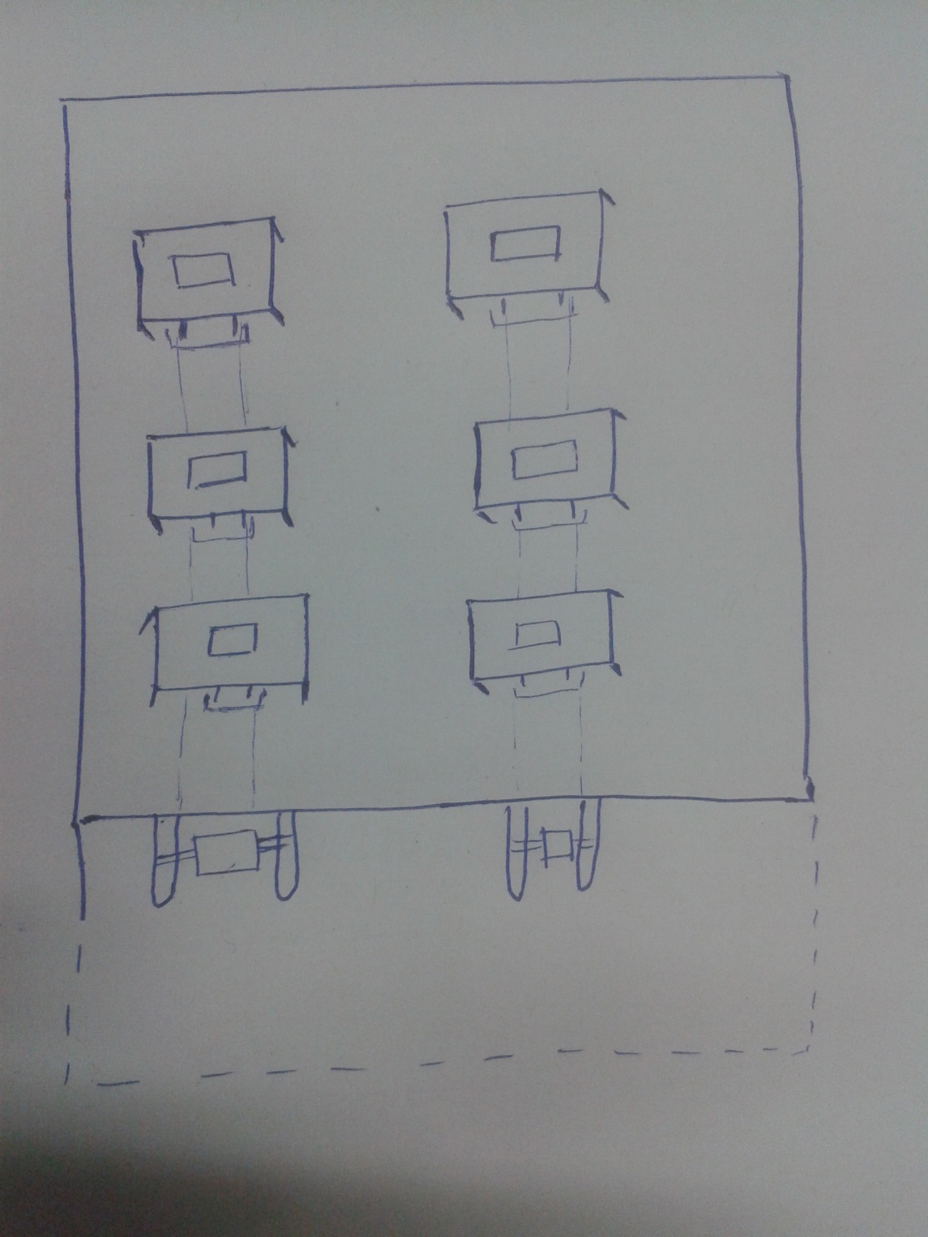
Restaurant arrangement

Slide 8
Impact:
  Customers get a new dining joint to visit.
  Customer satisfaction and great service.
  Service speed increased.
Market:
  A modernized hotel arrangement.
  Worth money service.

Slide 9
Competition:
  Being a kind of it’s own, it will manage to attract many customers.
  The dining at the dark can have issues with the conventional system. But by this, enjoying your food in this manner becomes doublefold.

Slide 10
Six Thinking Hats
Black Hat:
Can be expensive.
Power cut issues.
Technically difficult.
Yellow Hat:
Something new
Increases service speed rate
Customer satisfaction
Reduces the cost of waiters,,
One time investment. Cost can be earned over time.
Power backups, eg. Generators present.

Slide 11

Green Hat:
An innovative method of service at restaurants. Man replaced by gadgets.
Blue Hat:
Agenda- to break the non-conventional dining system.
To provide services through electronic equipments.

Slide 12
White Hat:
Man power not required.
Services provided by electronic gadgets.
Simple to use.
Red Hat:
Going to the same type of restaurants is monotonous. Don’t enjoy outings further.
Waiter’s might make mistakes in the order delivery.

Slide 13
Financial Help
Being costly, financing is required.
Bank loans and angel investors are a good option.
Total cost depends upon the size n working of the product.
Marketing Help
Approaching the reputed restaurants to convince them to change their current system to our opposed system.

Slide 14
Strategic Know-How
Hiring a sales dept to promote it.
Surveys at regular intervals to investigate customers opinion and whether changes required.

Slide 15
Thank You!

